Slide 1

Training program for
“Advanced Product Quality Planning
and Control Plan”

Slide 2
  INDEX
Sr. No. Trasnp.
1 What is APQP
2 Production Part Supplier without Design Resp.
3 Process Flow Diagram
4 APQP stand for
5 Plan and define program
6 Outputs by design resp. activity (Section 3.0)
7 Outputs (Section 4.0)
8 Feedback, assessment and corrective action
9 Control Plan Methodology
10 Characteristics
11 Control Method Example
12 Product Develop and Improve & APQP

Slide 3
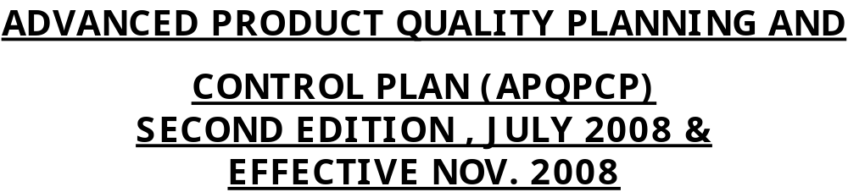
      What is APQP?
Advance Product Quality Planning is a structured method
of defining and establishing the steps necessary to assure
that a product satisfies the customer.
Effective product quality planning depends on a company’s
top management commitment to the effort required in
achieving customer satisfaction.

Slide 4
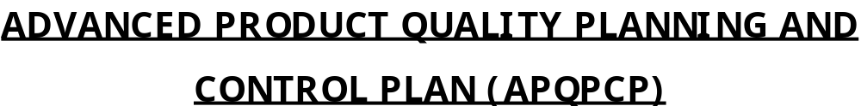
        The Objective of APQP
The goals of product quality planning are….
Effective communications with everyone involved.
On-time completion of all required steps.
Minimal or no quality problems.
Minimal product launch quality risks.

Slide 5
    Resources are directed toward customer satisfaction.
    Required changes are identified early.
    To avoid late Changes.
    A quality product is provided on time at the lowest cost.
APQP stands for advanced product quality planning.
Big three has published a manual on APQP.
This is to serve as a guideline for consistent approach to all users. Also refer scope for TS 16949 + Customer specific requirements.

Slide 6
ISO/TS 16949 refers to APQP in the following clauses:
Sr. No. Clause no. Description
1 5.1 Management Responsibility
2 7.1 Product Realization
3 7.3 Mfg. process design
4 7.5.1 Process Control
5 8.1, 8.4 Statistical Techniques

Slide 7
Contents | Design Resp. | Mfg. only
1. Plan and define program | Yes | --
2. Product design and development program | Yes | --
3. Process design and development program | Yes | Yes
4. Product and process validation program | Yes | Yes
5. Feedback assessment and corrective action | Yes | Yes
6. Control plan methodology | Yes | Yes

Slide 8
    Spend a little extra time upstream, so that life downstream is error free
    How you spend the time is very important

Slide 9

    Commitment
    Training
    Teamwork
    Logical methodology
    Sound techniques
    Documentation
    Communication
    feedback
ROBUST DESIGN
-- PROCESS

Slide 10
1.0 Plan and define program
    Inputs
Voice of the customer
- Market research
- Historical warranty and quality information
- Team experience
Business plan / marketing strategy
Product / process benchmark data
Product / process assumptions
Product reliability
Customer inputs

Slide 11
Outputs of Plan / Program
    Design goals
    Reliability and quality goals
    Preliminary bill of material
    Preliminary process flow chart
    Preliminary listing of special product and process characteristics
    Product assurance plan
    Management support (Plan, Training, Resources, provide staff, employee)

Slide 12
2.0 Product design and development
Inputs (derived from the outputs of Chapter 1.0)
    Design goals
    Reliability and quality goals
    Preliminary bill of material
    Preliminary process flow chart
    Preliminary listing of special product and process characteristics
    Product assurance plan
    Management support

Slide 13
    Design failure more and effects analysis (DFMEA)
    Design for manufacturibility and assembly
    Design verification
    Design reviews
    Prototype build – control plan
    Engineering drawings (including math data)
    Engineering specifications
    Material specifications
    Drawing and specification changes

Slide 14
APQP Outputs
    New equipment tooling and facilities requirements
    Special product and process characteristics
    Gauges / testing equipment requirement
    Team feasibility commitment and management support

Slide 15
3.0 Process design and development
Inputs Chapter
    Design failure more and effects analysis (DFMEA)
    Design for manufacturibility and assembly
    Design verification
    Design reviews
    Prototype build – control plan
    Engineering drawings (including math data)
    Engineering specifications
    Material specifications

Slide 16
3.0 Process design and development
Inputs Chapter
    Drawing and specification changes
    New equipment tooling and facilities requirements
    Special product and process characteristics
    Gauges / testing equipment requirement
    Team feasibility commitment and management support

Slide 17
Outputs of Process Design & Development
    Packaging standards & Specification
    Product process quality system review
    Process flow chart
    Floor plan layout
    Characteristics matrix
    Process failure mode and effects analysis (PFMEA)
    Pre-launch control plan
    Process instruction
    Measurement systems analysis plan
    Preliminary process capability study plan
    Management support

Slide 18
4.0 Product and process validation
Input
    Packaging standards & Specification
    Product process quality system review
    Process flow chart
    Floor plan layout
    Characteristics matrix
    Process failure mode and effects analysis (PFMEA)
    Pre-launch control plan
    Process instruction
    Measurement systems analysis plan
    Preliminary process capability study plan
    Management support

Slide 19
Outputs of Process validation
    Production trial run
    Measurement systems evaluation
    Preliminary process capability study
    Production part approval
    Production validation testing
    Packaging evaluation
    Production control plan
    Quality planning sign-off and management support

Slide 20
5.0 Feedback, assessment and corrective action
Inputs
    Production trial run
    Measurement systems evaluation
    Preliminary process capability study
    Production part approval
    Production validation testing
    Packaging evaluation
    Production control plan
    Quality planning sign-off and management support

Slide 21
    Outputs
Reduced variation
Customer satisfaction
Delivery and service
Improve effective use of lessons learned / best practices

Slide 22
Control plans
This is a description of systems for controlling parts and processes.
A single control plan may apply to a group or family of products that are produced by the same process.
Prepared for each phase of the process including incoming, in process, final and product audit requirements to assure that all process outputs in a state of control.
Prepared by a multi-disciplinary team. (CFT)
Provision for customer approval.
Refer SPC Requirements, mistake proofing (Poka Yoke) as control methods.

Slide 23
    Prepared for three distinct phases
    Prototype
    Pre-launch
    Production
    Control shall be derived from the outcome of process FMEA.
    The document shall be reviewed & updated – when process is changed, unstable or not capable.

Slide 24
APQP TABLE (REQUIREMENTS)
Sr. No. | Subject | Plan & Development | Validation plan | Outputs | Feed back / Assessment / Corrective action | Remarks
1 | Packaging standards and specifications | Y | Y | Packaging evaluation | Y
2 | Product/Process quality system review | Y | Y | Production validation testing, Significant production run | Y
3 | Process flow chart | Y | Y | -- | Y
4 | Floor plan layout | If applicable | If applicable | -- | If applicable
5 | Characteristics matrix | If applicable | If applicable | -- | If applicable
6 | Process failure mode and effective analysis (PFMEA) | Y | If applicable | -- | Y
7 | Pre-launch control plan | If applicable | If applicable | Production control plan | Y
8 | Process Instruction | Y | Y | Process Audit | Y
9 | Measurement system analysis plan | Y | Y | Measurement system evaluation | Y
10 | Preliminary process capability study plan | Y | Y | Preliminary process capability study | Y
11 | Management support | Y | Y | Quality planning sign-off and management support | Y
 |  |  |  | PPAP | Y / PSW

Slide 25
    Describe the controls required on product as well as process characteristics.
    Identify special characteristics
    (All special characteristics must be listed in control plan).
    Identify the measurement process
    Specify the corrective action required, whenever the process goes out of control; specify the people responsible to carry out this.

Slide 26
Control plan methodology
Prototype, pre-launch, production
Control plan number
Part number / latest change level
Part name / description
Supplier / plant
Supplier code
Key contact / phone
Core team

Slide 27
Control plan methodology
    Supplier / plant approval / date
    Date (orig.)
    Date (rev.)
    Customer engineering approval/ date (if reqd.)
    Customer quality approval / date (if reqd.)
    Other approval / date (if reqd.)
    Part / process number
    Process name / operation description
    Machine, device, jig, tools for manufacturing

Slide 28
Characteristics
Number
Product
Process
Special characteristics classification

Slide 29
Methods
    Product / process specification / tolerance
    Evaluation / measurement technique
    Sample size / frequency
    Control method
    Reaction plan

Slide 30
Control Method Example
Type of Variation Class Control Method *
Machine Dominant Rework or replace machine
Extensive P.M. program
Variable SPC charts
Mistake proofing
Special Machine instructions
Yearly Layout
Etc.
Operator Dominant Certify operator and training
Visual aids
Mistake proofing
Time and motion studies
Checklists
Etc.
Heat treatment, Molding,
Casting
Painting, Assly., Welding
Brazing

Slide 31
Component Dominant Certify supplier
Single source
Incoming inspection
Visitation program
Inspection layout
Etc.
Tools Dominant Tool sharpening instructions
SPC on Tool wear
Tool setup instructions
Etc.
All Processes
CNC Turning, Milling,
Drilling, Gear cutting,
Broaching, Hobbing

Slide 32
Preventive Maintenance Dominant Maintenance schedule
Maintenance instructions
Checklist
Training
Etc.
Fixture/ Pallet/ Position Dominant Standardized size of pallet / fixture
Wear history
Layout inspection
Etc.
Setup Dominant Setup Training
First piece inspection
Checklists
Etc.
Environment Dominant Protect machinery
Monitor environmental parameters
Etc.
All Conventional, Paint shop,
Auto production system
Assly., Drilling, Milling, VMC
CNC M/C, Welding,
Surface treatment, Mouldings
S.T., Assly., Injection plastic
Moulding, Painting, Spl. processes
For all class use SPC charts, error proofing *

Slide 33
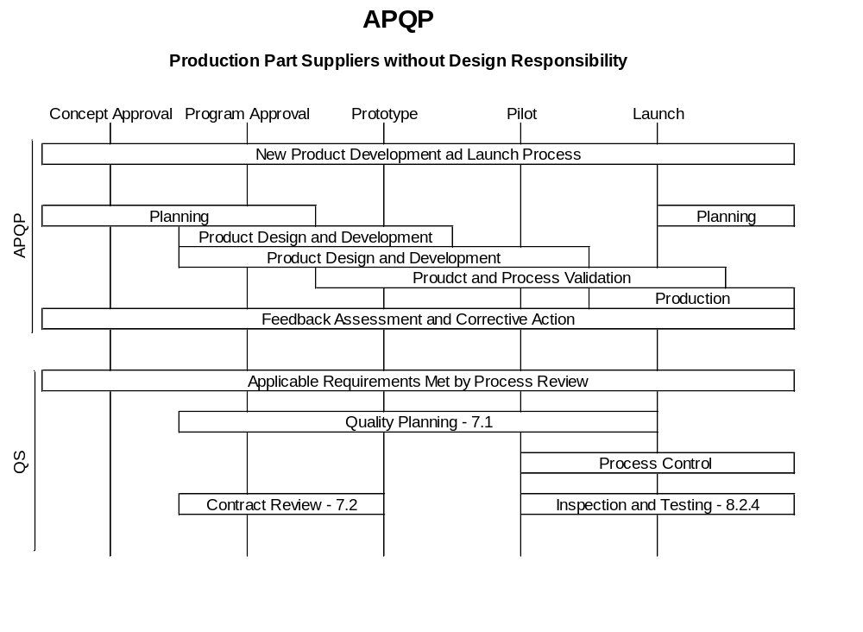

Slide 34
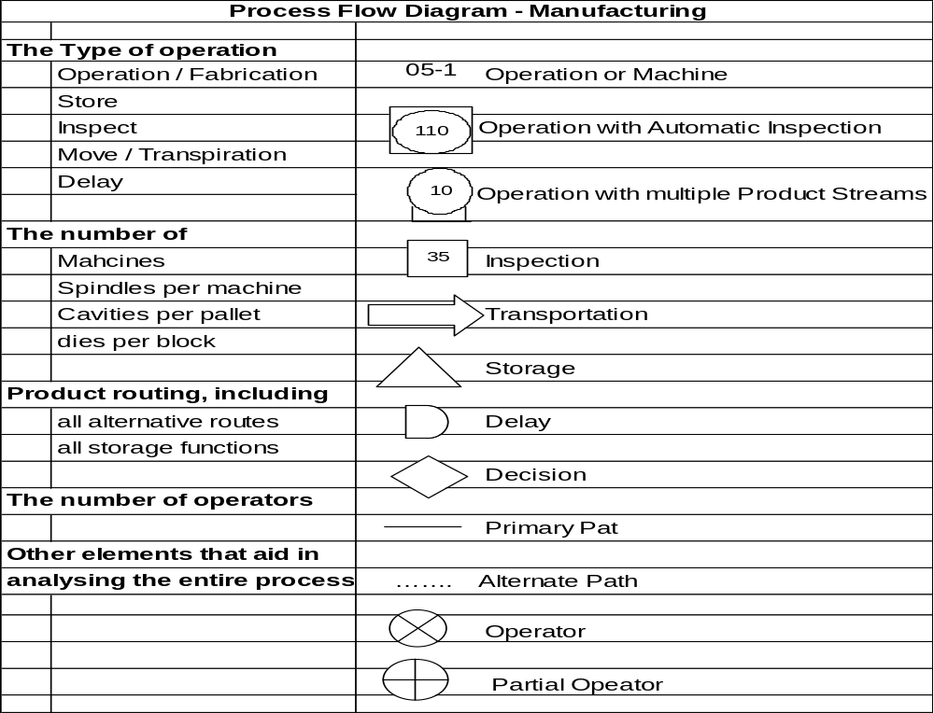

Slide 35
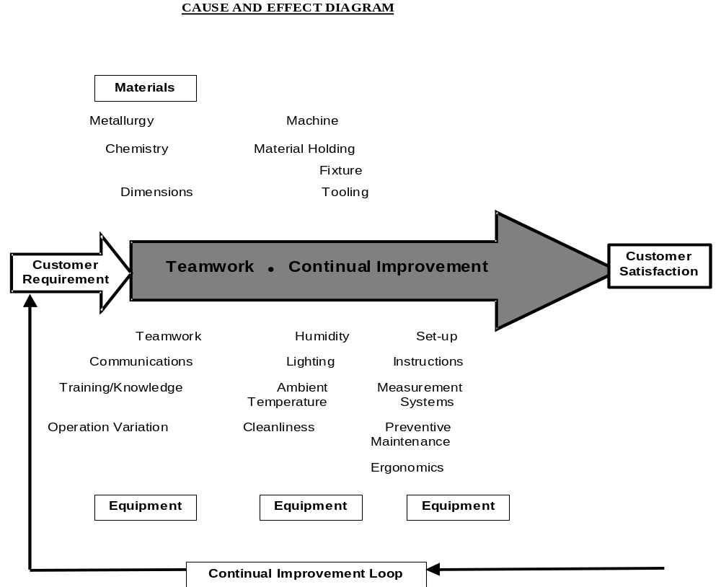
Equipment

Slide 36
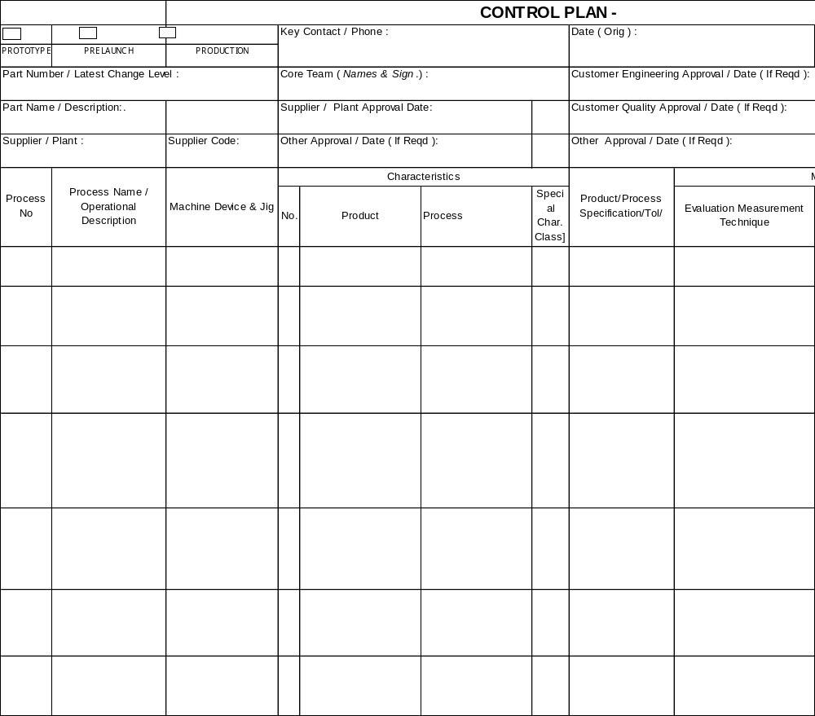

Slide 37
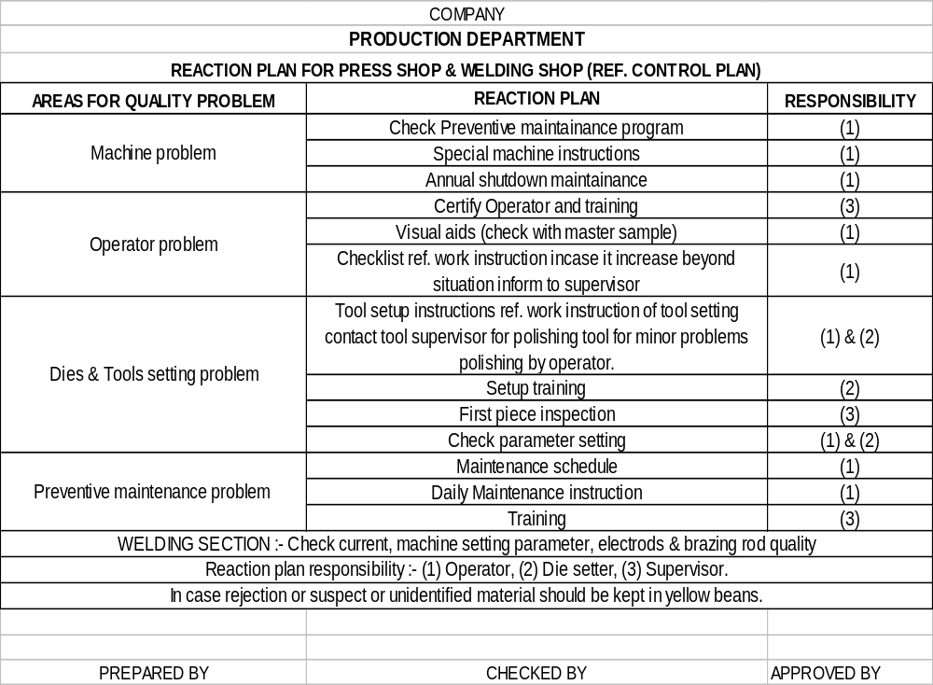

Slide 38
Supplier (Readiness) Review
Assessment Report
Supplier Name : ____________________ |  |  | Program(s):______________
Supplier Location : __________________ |  |  | Review Date:_____________
Supplier Manufacturing Code:__________ |  |  | Follow-up Date:___________
Assessment Item / Readiness | Status | Deficiencies | Recovery Plan | Due | Resp. Person's Name
 | (GYR) | (if Status R or Y) | (if Status R or Y) | Date
1. Product Readiness
2. Process Planning Readiness
3. Production Process
4. Production Capacity
5. Measurement & Testing
Systems Readiness
6. Sub-supplier Readiness
7. Material Handling Systems
8. Personnel Readiness
9. Quality System Readiness
10. PSW Readiness
Q.A. Prod. Dev. / Mkt. Customer
G/Y/R Def. : G - On schedule / High QoE / Meets Y - Behind schedule, R - Behind schedule, No Recovery
Objectives Concurred recovery plan in place. plan in place. Unacceptable QoE.
 |  |  |  | Does not meet objectives

